Slide 1
The CTA Summer Institute
IPD Strand at UCLA
(Instruction & Professional Development)
Common Core State Standards
&
Smarter Balanced Assessment

Slide 2
Rationale behind the switch to Common Core Standards
Depth and Breadth
Studies of other countries whose students score high…
New Blooms Taxonomy Updated
Webb’s Depth of knowledge Levels
College and Career Readiness - 21st Century Learning

Slide 3
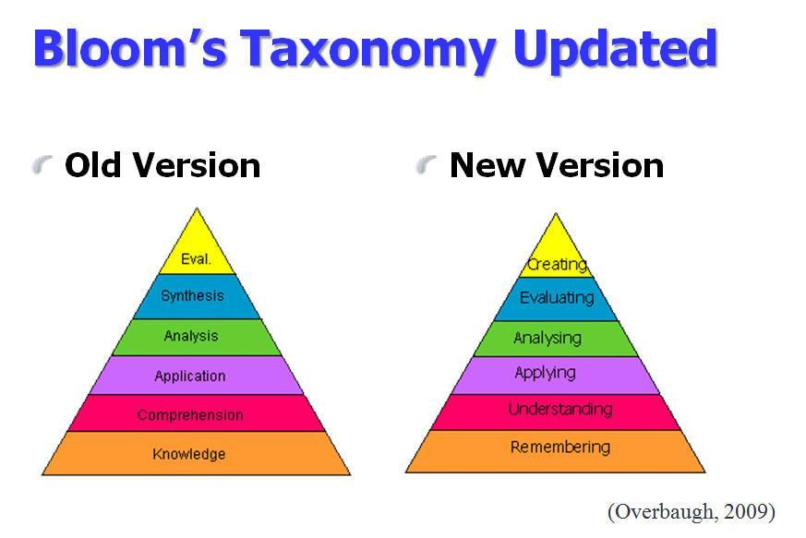
Common Core Standards
1997 Standards
Nouns
Verbs
Notes:
Common Core standards and 21st Century learning is driven by the creation process. Students no longer just need "know" information. Now, they need to know what to do with it.

Slide 4
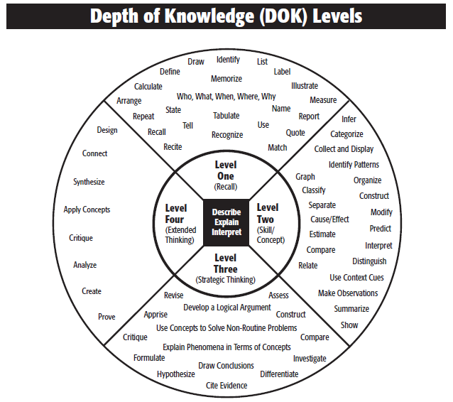
Webb, 2006

Slide 5
Common Core State Standards bring more breadth and depth by emphasizing the full range of thinking skills
Draw
Identify
List
  E.g., Perform routine procedures like measuring length or using punctuation marks
  E.g., Support ideas with details and examples, design investigations
Define
Memorize
Calculate
Illustrate
Arrange
Who, What, When, Where, Why
Measure
Repeat
Tabulate
Name
Design
Recall
Match
Categorize
Recognize
Use
Connect
Level One
(Recall)
Infer
Synthesize
Graph
Organize
  E.g., Conduct a project that requires specifying a problem, designing and conducting an experiment, analyzing its data, and reporting results/solutions
Level Four
Classify
Apply Concepts
Describe Explain Interpret
Level Two
(Skill/
Concept)
Modify
Cause/Effect
(Extended Thinking)
Relate
Critique
Predict
  E.g., Identify and summarize the major events in a narrative
Prove
Level Three
(Strategic Thinking)
Compare
Analyze
Interpret
Estimate
Create
Revise
Assess
Develop a Logical Argument
Summarize
Critique
Use Concepts to Solve
Non-Routine Problems
Construct
Show
Apprise
Investigate
Compare
Formulate
Explain
Draw Conclusions
Hypothesize
Differentiate
Source: Webb, Norman L. and others, “Web Alignment Tool” 24 July 2005. Wisconsin Center of Educational Research, University of Wisconsin-Madison, 2 Feb 2006

Slide 6
Transitioning to the Smarter Balance Assessment
Deb Sigman, Deputy Superintendent
CA State Superintendent of Public Education Tom Torlakson’s Office
Currently NCLB (federal law) requires the States to test grades 3 – 12 for federal funding
AB 484 (Bonilla Bill) - If passed, will suspend all state tests not Federally required for Spring 2014.
Some districts will pilot the SBA 2013-2014 in lieu of STAR. There are lots of kinks to work out!!!
The STAR is scheduled to sunset July 2014 & SBA will be fully implemented for 2014 – 2015 grades 3 – 12.
The SBA is an adaptive computer test that goes beyond multiple choice. It is also timed.
The SBA assumes a certain level of proficiency in use of technology even by grade 3.
Try it out on both a PC and an iPad. It will be a different experience.

Slide 7
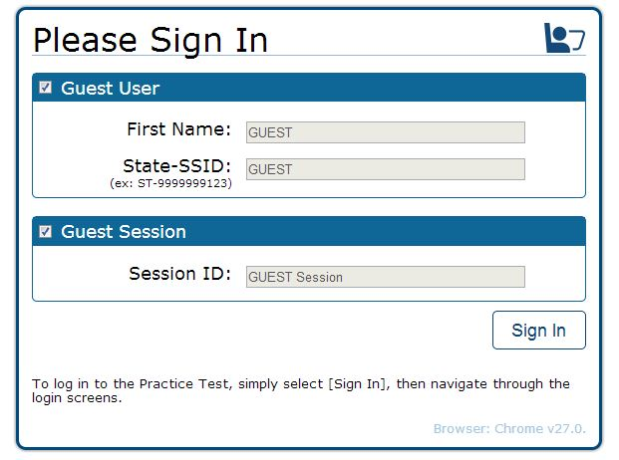
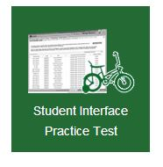
Give it a try!
http://sbac.portal.airast.org/Practice_Test
Click on icon
Notes:
This is an example of an ELA technology-enhanced item for grade 8. For this item, students begin by reading a poem. Next, students find and
{+}
highlight lines in the text that reveal a change in the speaker’s message. Depending on how the item writer designed the item, students are able to select one or more blocks of text in the poem.

Slide 8

Time line is BACKWARDS in California
The 1997 implementation of the CA Standards
  Standards were created
  Frameworks for each subject
  State adoption of textbooks
  Prof. dev. (statewide)
  CA State Standardized Test implemented
The 2014 implementation of the CCSS Standards
  Standards were created
  Little to some prof. dev. Statewide (district)
  SBA implemented
  Prof. dev. (statewide)
  Create Frameworks
  State adoption of text books

Slide 9
CTA Concerns
Test scores will drop first few years
No state wide professional development
LCFF has one time funds for implementation of CCS
  – ESTA needs a voice in how those funds are spent.
Teacher evaluations - STULL Bill 44662 a & b
  No Frameworks yet – criteria for evaluation is unrealistic

Slide 10
Dr. Marcia Tate
Developing Minds, Inc.
Atlanta, GA
Brain Compatible Environments
Brain Compatible Lessons
  Increased achievement for ALL students
  Decreased behavior problems
  Make teaching and learning fun

Slide 11
20 Strategies to incorporate into your lessons that take advantage of how the brain learns best:
Writing
Storytelling
Mnemonic devices (Acrostics & Acronyms)
Visuals
Movement
Roll play
Visualization
Metaphor/analogy & simile
Reciprocal teaching & cooperative learning
Music (mood, connections & memory)
Graphic Organizers
Symbolic Drawing
Humor
Discussion (Collaborative Communication)
Games
Project-based Instruction
Field trips
Manipulatives
Technology
Work-Study (apprenticeships and internships)

Slide 12
“Not everything
That counts
Can be counted,
and not everything
THat can be counted,
counts.“
Albert Einstein

